Slide 1
Image and Video Processing

Slide 2
III.3 Wavelet Denoising for Image Enhancement
1 Introduction
2 Wavelet Transform
3 Wavelet Shrinkage Denoising
4 Image Enhancement Wavelet Shrinkage
5 Examples

Slide 3
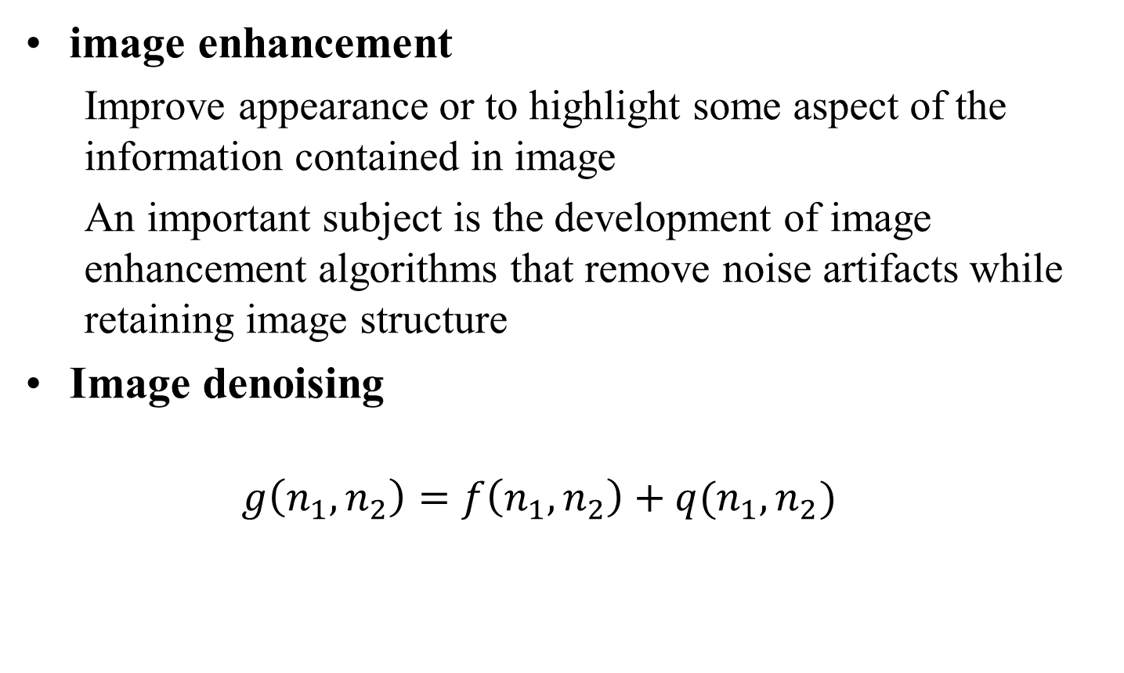
1 Introduction
image enhancement
Improve appearance or to highlight some aspect of the information contained in image
An important subject is the development of image enhancement algorithms that remove noise artifacts while retaining image structure
Image denoising
$$g\left(n_{1},n_{2}\right)=f\left(n_{1},n_{2}\right)+q(n_{1},n_{2})$$
Notes:
改善外观或突出显示图像中包含的信息的某些方面 一个重要的主题是图像增强算法的开发，该算法可在保留图像结构的同时消除噪声伪像

Slide 4
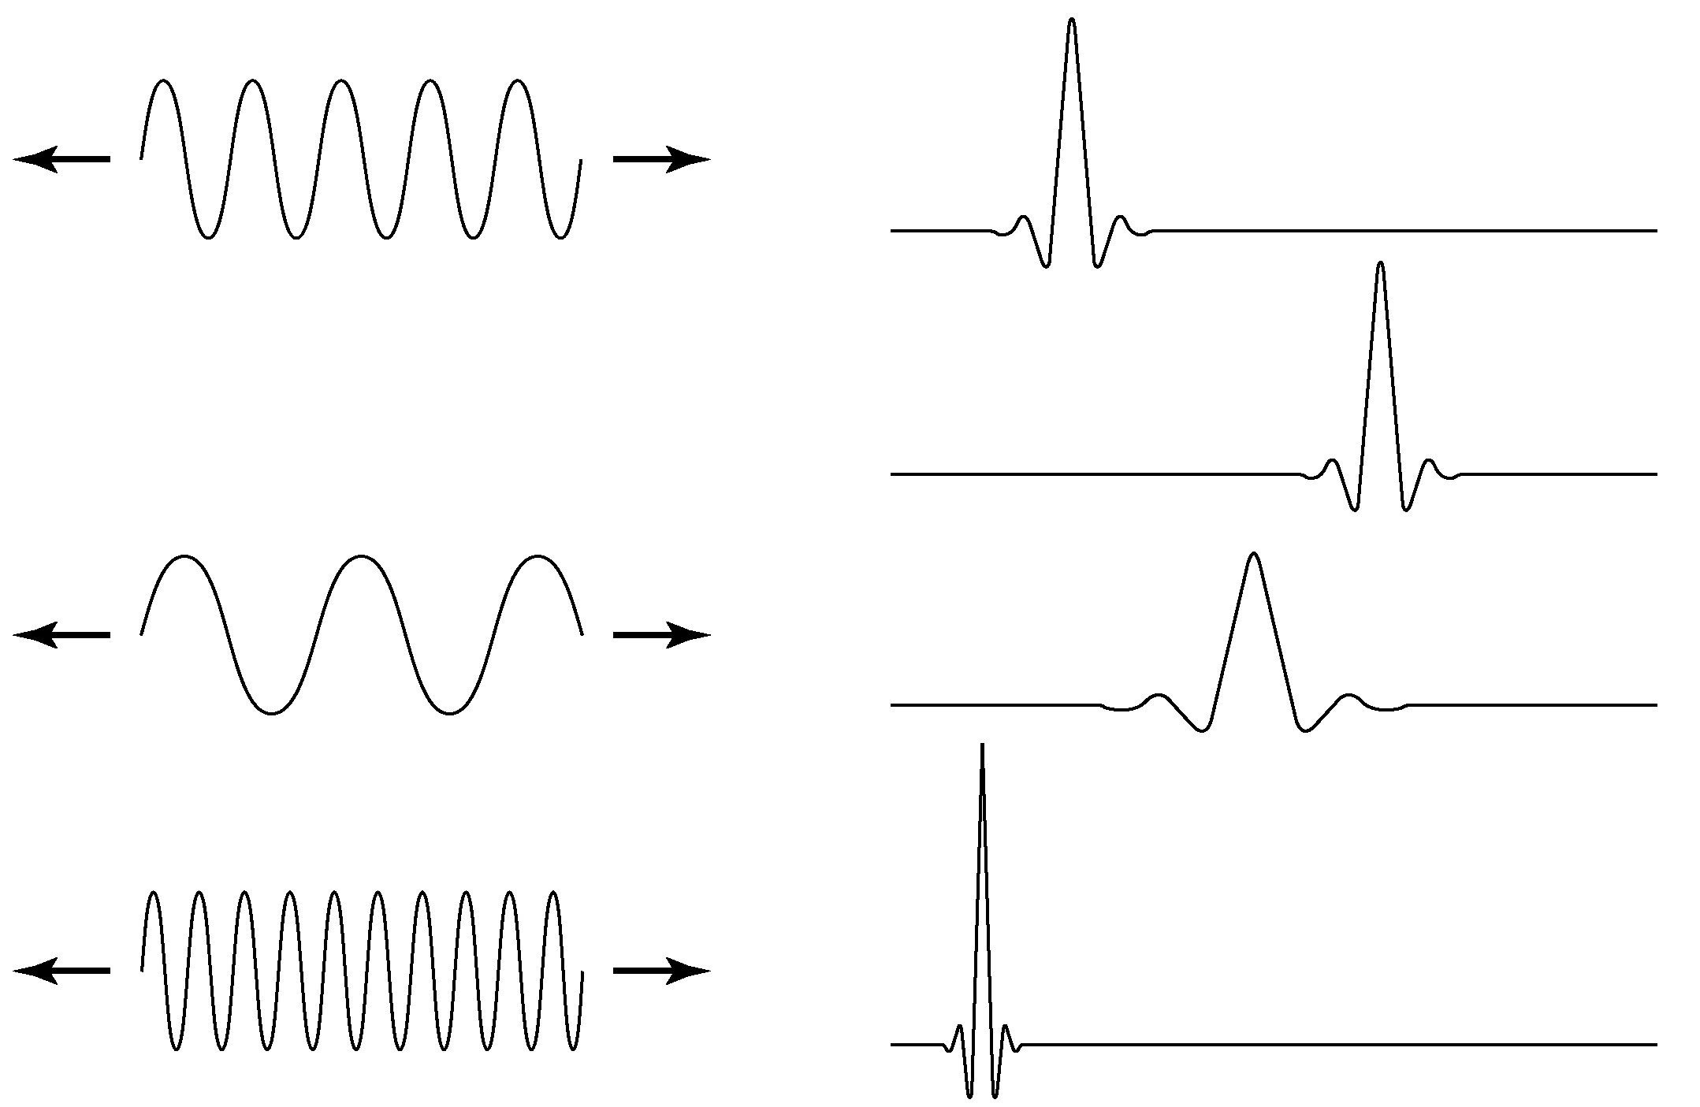
1 Introduction
a) b)
a) The familiar Fourier expansion function sinusoids of varying frequency and infinite duration b) DWT expansion functions are “small wave” of finite duration and varying frequency

Slide 5
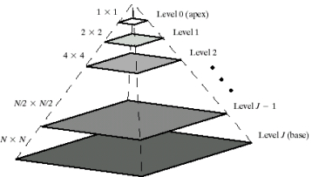
1 Introduction
Multiresolution theory
Image pyramids
an image pyramid is a collection of decreasing resolution images arranged in the shape of a pyramid
the base of the pyramid contains a high-resolution representation of the image being processed; the apex contains a low-resolution approximation
Notes:
多分辨率理论
图像金字塔是按金字塔形状排列的递减分辨率图像的集合
金字塔的底部包含正在处理的图像的高分辨率表示； 顶点包含低分辨率近似值

Slide 6
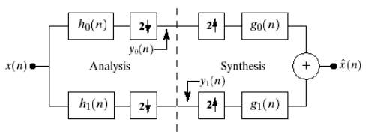
1 Introduction
Multiresolution theory
Subband coding
in subband coding, an image is decomposed into a set of bandlimited components, called subbands. The decomposition is performed so that the subbands can be reassembled to reconstruct the original image without error .
Notes:
在子带编码中，图像被分解为一组带宽受限的分量，称为子带。 执行分解，以便可以重新组合子带以重建原始图像，而不会出现错误。

Slide 8

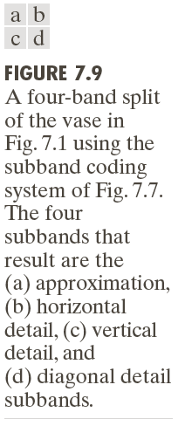

Slide 9
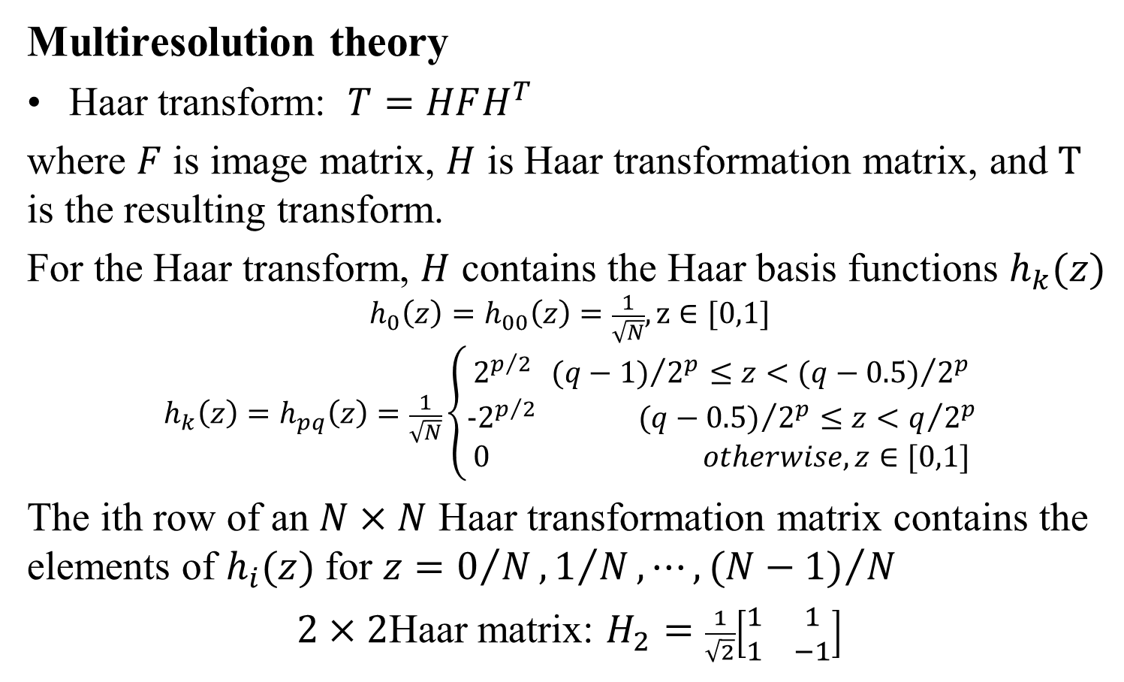
1 Introduction
Multiresolution theory
Haar transform: $T=HFH^{T}$
where $F$ is image matrix, $H$ is Haar transformation matrix, and $T$ is the resulting transform.
For the Haar transform, $H$ contains the Haar basis functions $h_{k}(z)$
$$h_{0}\left(z\right)=h_{00}\left(z\right)=\frac{1}{\sqrt{N}}, z∈[0,1]$$
$$h_{k}\left(z\right)=h_{pq}\left(z\right)=\frac{1}{\sqrt{N}}\left\{\begin{aligned}2^{p/2} {(q−1)}/{2^{p}}≤z<{(q−0.5)}/{2^{p}} \\ {−2}^{p/2} {(q−0.5)}/{2^{p}}≤z<q/{2^{p}} \\ 0 otherwise, z∈[0,1]\end{aligned}\right.$$
The ith row of an $N×N$ Haar transformation matrix contains the elements of $h_{i}(z)$ for $z=0/N,1/N,⋯,{(N−1)}/N$
$2×2$Haar matrix: $H_{2}=\frac{1}{\sqrt{2}}\left[\begin{matrix}1 & 1 \\ 1 & −1\end{matrix}\right]$
Notes:
哈尔小波是已知的最古老最简单的正交小波

Slide 10
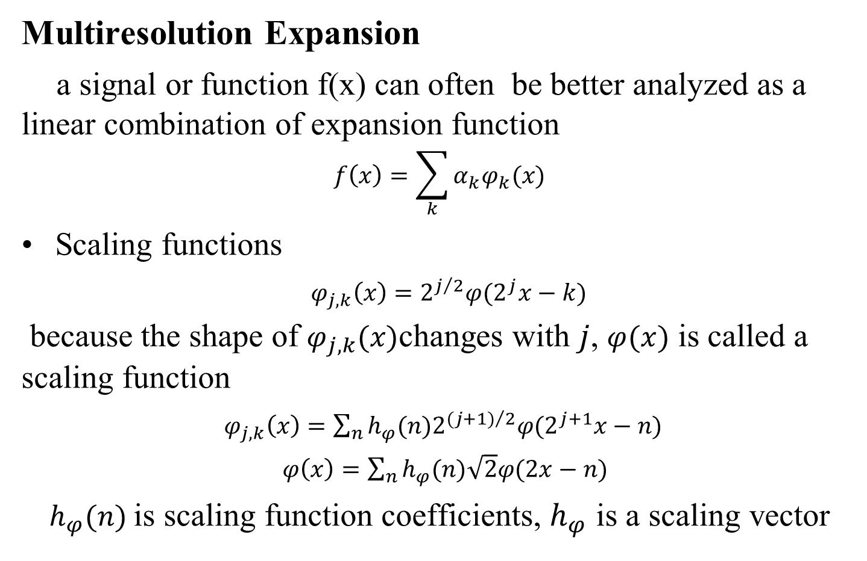
1 Introduction
Multiresolution Expansion
a signal or function f(x) can often be better analyzed as a linear combination of expansion function
$$f\left(x\right)=\sum_{k}{α_{k}φ_{k}(x)}$$
Scaling functions
$φ_{j,k}\left(x\right)=2^{j/2}φ(2^{j}x−k)$
because the shape of $φ_{j,k}(x)$changes with $j$, $φ(x)$ is called a scaling function
$φ_{j,k}\left(x\right)=\sum_{n}{{h_{φ}(n)2}^{{(j+1)}/2}φ(2^{j+1}x−n)}$
$φ\left(x\right)=\sum_{n}{h_{φ}(n)\sqrt{2}φ(2x−n)}$
$h_{φ}(n)$is scaling function coefficients, $h_{φ}$ is a scaling vector

Slide 11
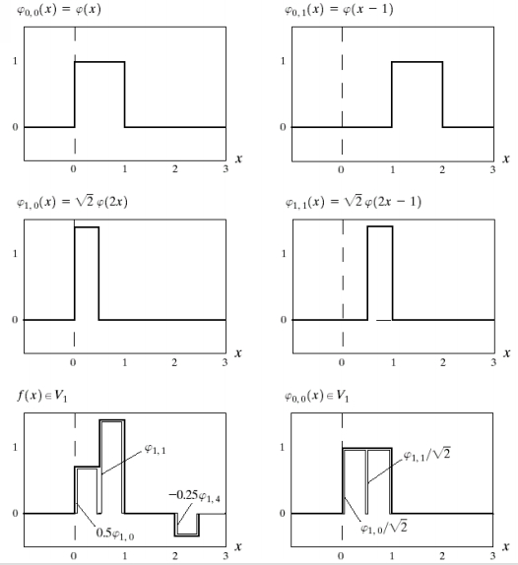
1 Introduction
Multiresolution Expansion
Scaling functions

Slide 12
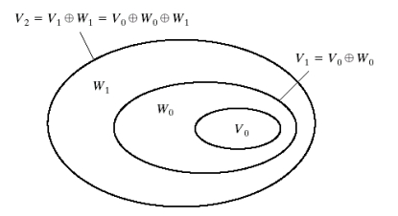
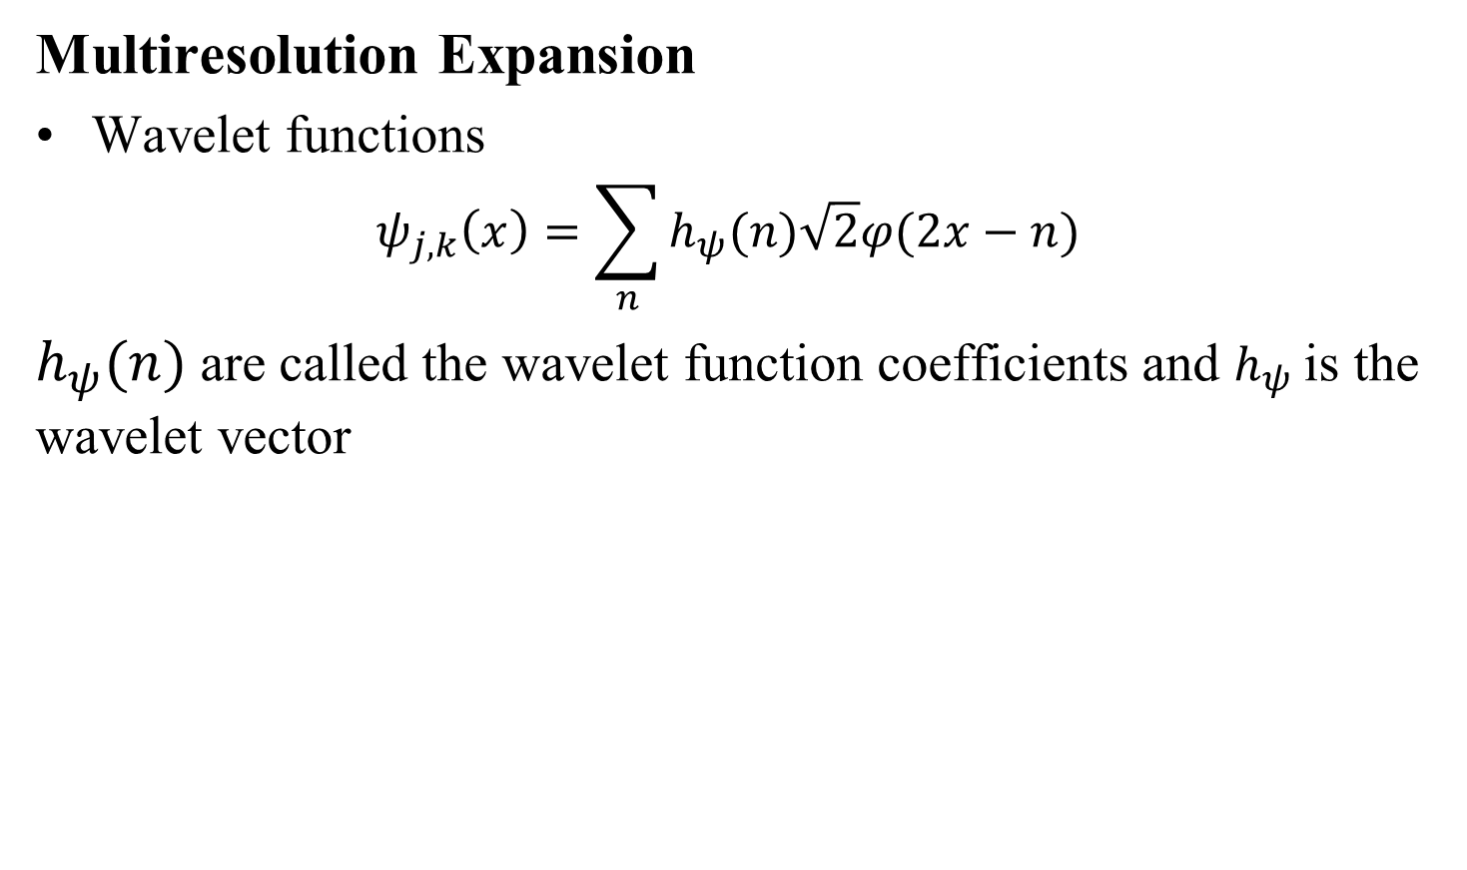
1 Introduction
Multiresolution Expansion
Wavelet functions
$$ψ_{j,k}\left(x\right)=\sum_{n}{h_{ψ}(n)\sqrt{2}φ(2x−n)}$$
$h_{ψ}(n)$are called the wavelet function coefficients and $h_{ψ}$is the wavelet vector
The relationship between scaling and wavelet function spaces

Slide 13
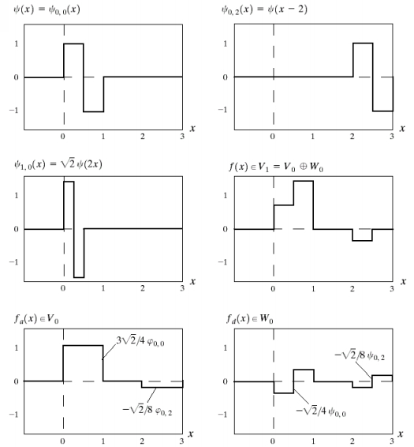
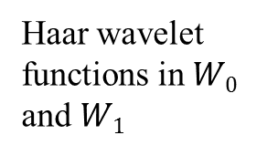
1 Introduction
Haar wavelet functions in $W0$ and $W1$

Slide 14
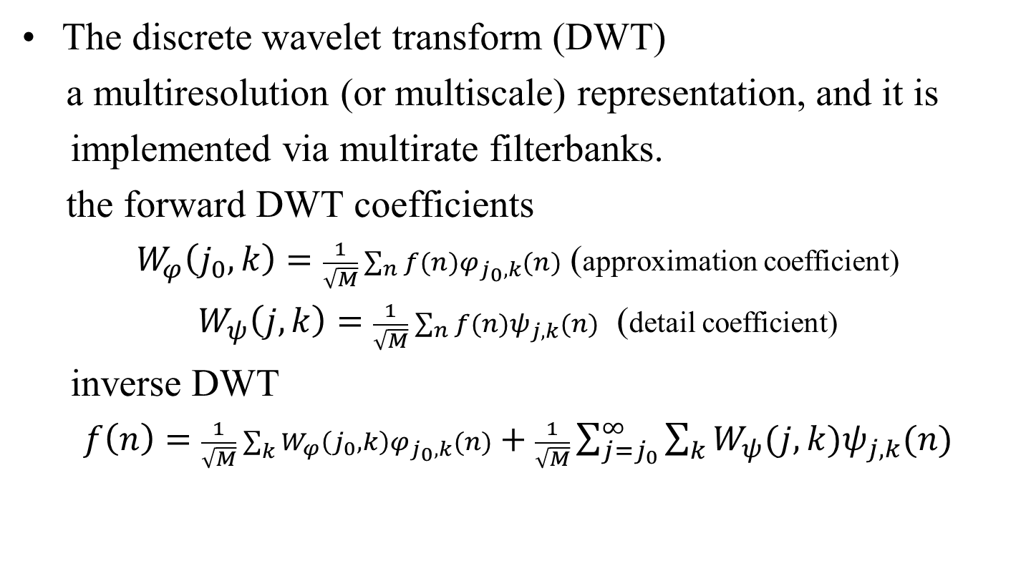
2 Wavelet Transform 2.1 The Discrete Wavelet Transform
The discrete wavelet transform (DWT)
a multiresolution (or multiscale) representation, and it is
implemented via multirate filterbanks.
the forward DWT coefficients
$W_{φ}\left(j_{0},k\right)=\frac{1}{\sqrt{M}}\sum_{n}{f(n)φ_{j_{0},k}(n)}$ (approximation coefficient)
$W_{ψ}\left(j,k\right)=\frac{1}{\sqrt{M}}\sum_{n}{f(n)ψ_{j,k}(n)}$ (detail coefficient)
inverse DWT
$f\left(n\right)=\frac{1}{\sqrt{M}}\sum_{k}{W_{φ}\left(j_{0},k\right)φ_{j_{0},k}(n)}+\frac{1}{\sqrt{M}}\sum_{j=j_{0}}^{∞}{\sum_{k}{W_{ψ}(j,k)ψ_{j,k}(n)}}$

Slide 15
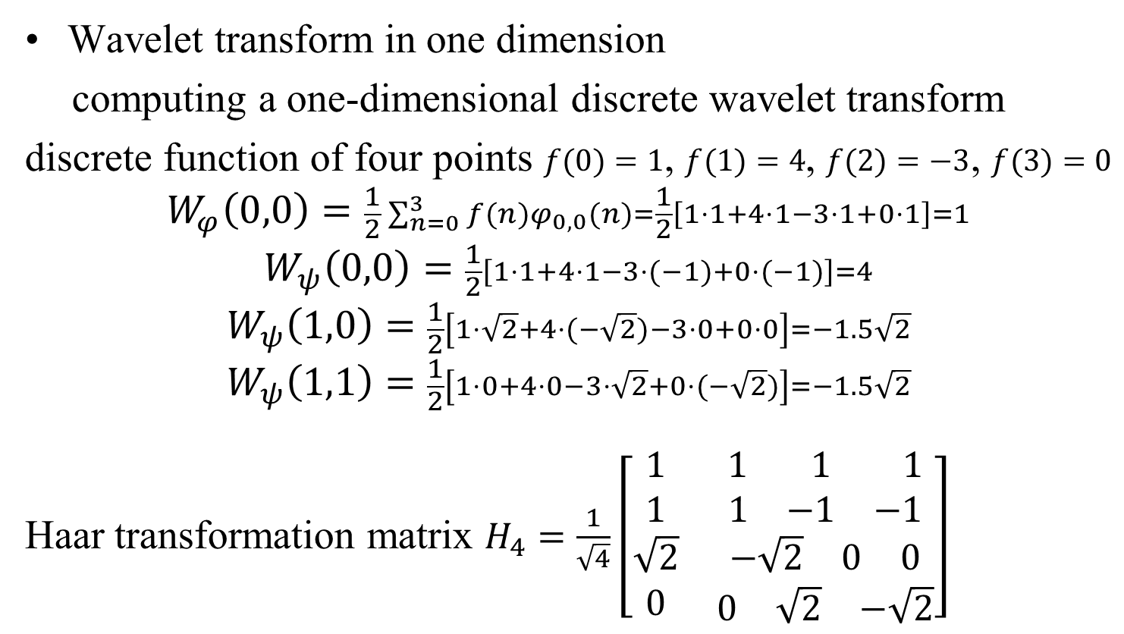
2 Wavelet Transform 2.1 The Discrete Wavelet Transform
Wavelet transform in one dimension
computing a one-dimensional discrete wavelet transform
discrete function of four points $f(0)=1$, $f(1)=4$, $f(2)=−3$, $f(3)=0$
$$W_{φ}\left(0,0\right)=\frac{1}{2}\sum_{n=0}^{3}{f(n)φ_{0,0}(n)}=\frac{1}{2}\left[1⋅1+4⋅1−3⋅1+0⋅1\right]=1$$
$$W_{ψ}\left(0,0\right)=\frac{1}{2}\left[1⋅1+4⋅1−3⋅(−1)+0⋅(−1)\right]=4$$
$$W_{ψ}\left(1,0\right)=\frac{1}{2}\left[1⋅\sqrt{2}+4⋅(−\sqrt{2})−3⋅0+0⋅0\right]=−1.5\sqrt{2}$$
$$W_{ψ}\left(1,1\right)=\frac{1}{2}\left[1⋅0+4⋅0−3⋅\sqrt{2}+0⋅(−\sqrt{2})\right]=−1.5\sqrt{2}$$
Haar transformation matrix $H_{4}=\frac{1}{\sqrt{4}}\left[\begin{matrix}\begin{matrix}1 \\ 1 \\ \sqrt{2}\end{matrix} & \begin{matrix}\begin{matrix}1 & 1 & 1\end{matrix} \\ \begin{matrix}1 & −1 & −1\end{matrix} \\ \begin{matrix}−\sqrt{2} & 0 & 0\end{matrix}\end{matrix} \\ 0 & \begin{matrix}0 & \sqrt{2} & −\sqrt{2}\end{matrix}\end{matrix}\right]$

Slide 16
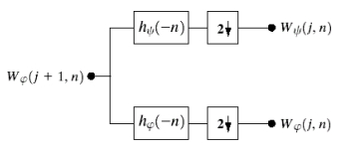
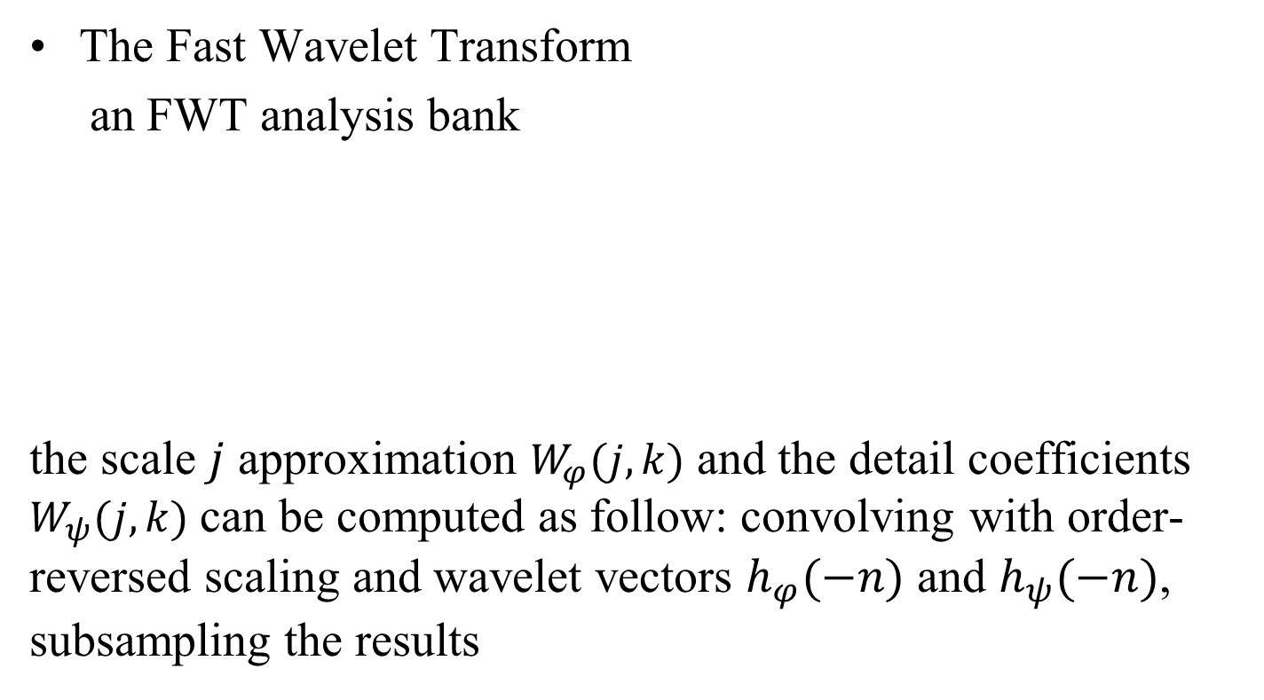
2 Wavelet Transform 2.1 The Discrete Wavelet Transform
The Fast Wavelet Transform
an FWT analysis bank
the scale $j$ approximation $W_{φ}(j,k)$ and the detail coefficients $W_{ψ}(j,k)$ can be computed as follow: convolving with order-reversed scaling and wavelet vectors $h_{φ}(−n)$ and $h_{ψ}(−n)$, subsampling the results

Slide 17
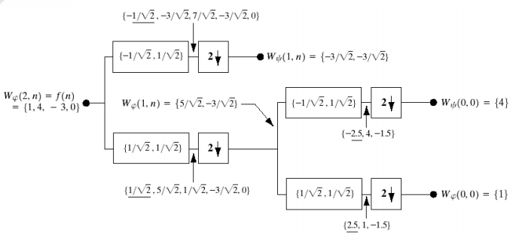
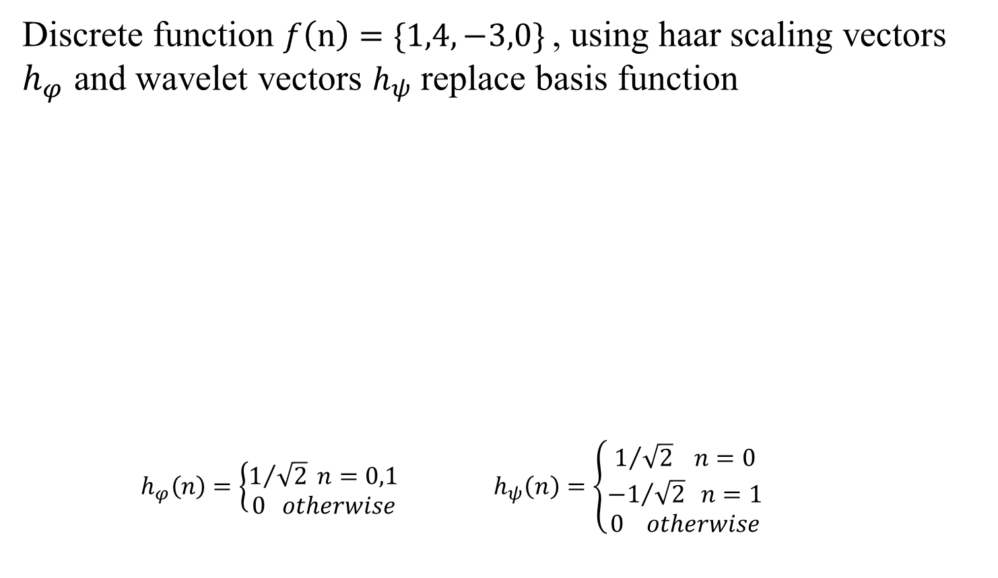
2 Wavelet Transform 2.1 The Discrete Wavelet Transform
Discrete function $f\left(n\right)=\{1,4,−3,0\}$, using haar scaling vectors $h_{φ}$ and wavelet vectors $h_{ψ}$ replace basis function
$h_{φ}\left(n\right)=\left\{\begin{aligned}1/{\sqrt{2}} n=0,1 \\ 0 otherwise\end{aligned}\right.$ $h_{ψ}\left(n\right)=\left\{\begin{aligned}1/{\sqrt{2}} n=0 \\ {−1}/{\sqrt{2}} n=1 \\ 0 otherwise\end{aligned}\right.$

Slide 18
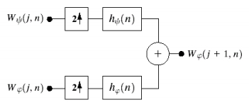
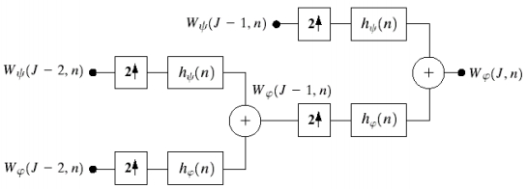
2 Wavelet Transform 2.1 The Discrete Wavelet Transform
The output of the inverse DWT is identical to the input of the forward DWT and the resulting DWT is an orthonormal transform

Slide 19
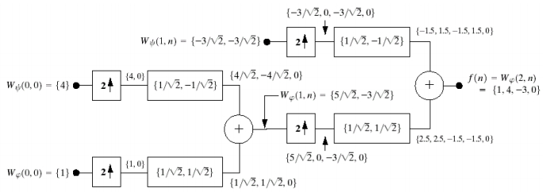
2 Wavelet Transform 2.1 The Discrete Wavelet Transform
The output of the inverse DWT is identical to the input of the forward DWT and the resulting DWT is an orthonormal transform

Slide 20
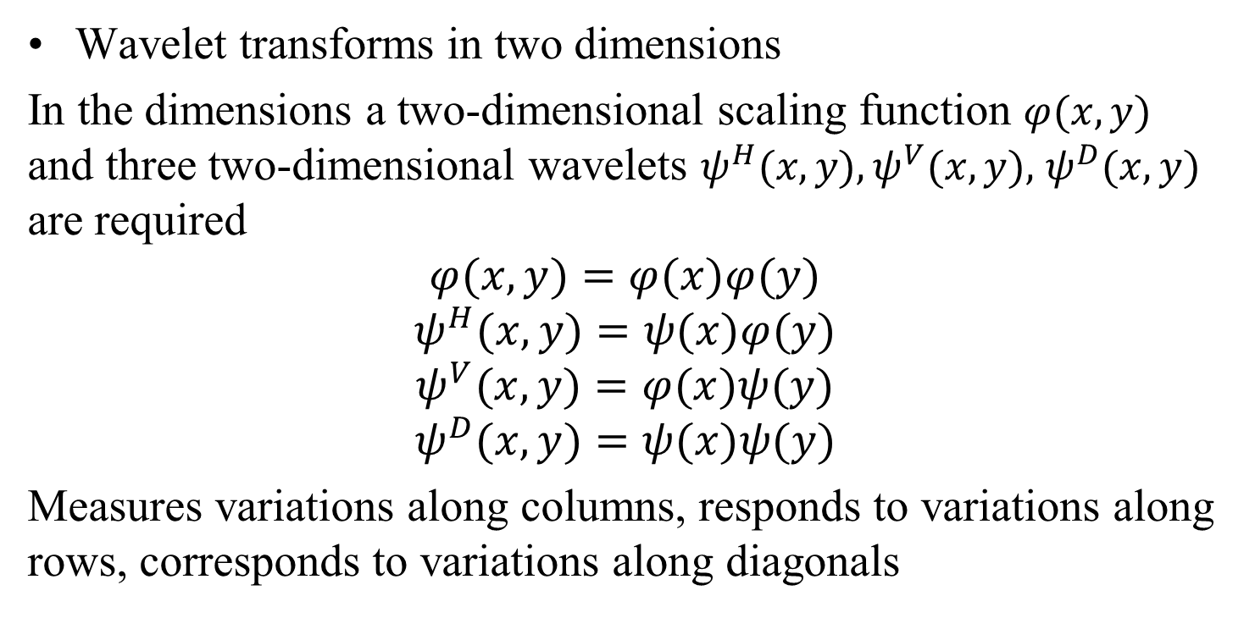
2 Wavelet Transform 2.1 The Discrete Wavelet Transform
Wavelet transforms in two dimensions
In the dimensions a two-dimensional scaling function $φ(x,y)$ and three two-dimensional wavelets $ψ^{H}(x,y),ψ^{V}(x,y),$ $ψ^{D}(x,y)$ are required
$$φ(x,y)=φ(x)φ(y)$$
$$ψ^{H}(x,y)=ψ(x)φ(y)$$
$$ψ^{V}(x,y)=φ(x)ψ(y)$$
$$ψ^{D}(x,y)=ψ(x)ψ(y)$$
Measures variations along columns, responds to variations along rows, corresponds to variations along diagonals

Slide 21
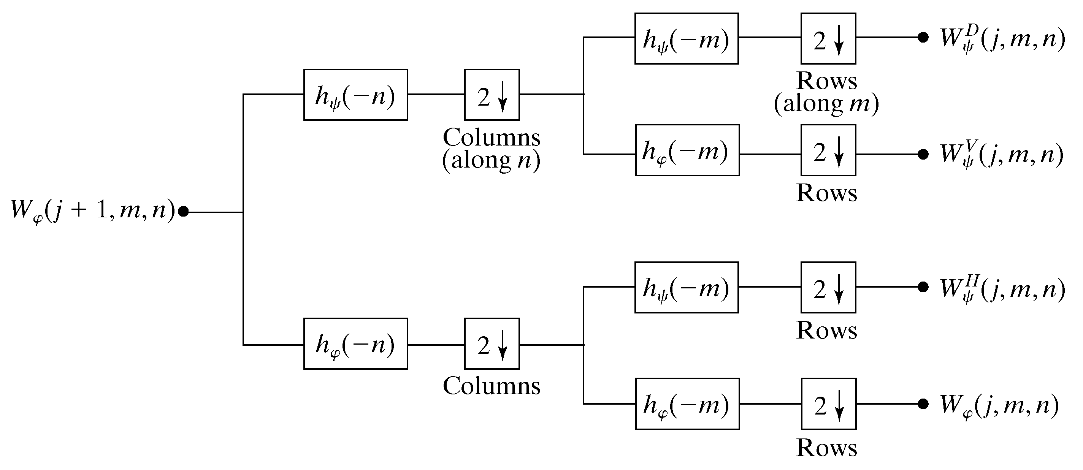
2 Wavelet Transform 2.1 The Discrete Wavelet Transform
2-D fast wavelet transform: the analysis filter bank

Slide 22
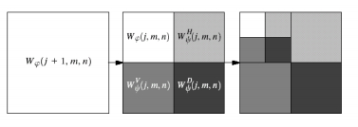
2 Wavelet Transform 2.1 The Discrete Wavelet Transform
two-level inverse DWT
The inner products of f(x,y) and two-dimensional scaling and wavelet function, downsampling by 2 in each dimension.

Slide 23
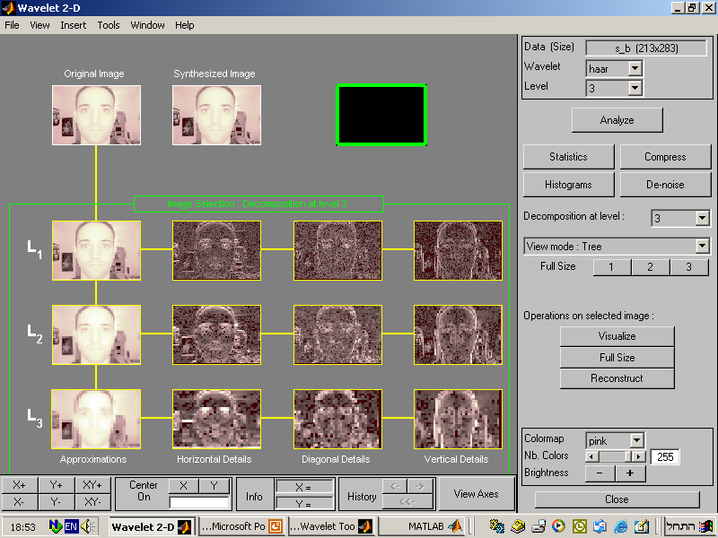

Slide 24
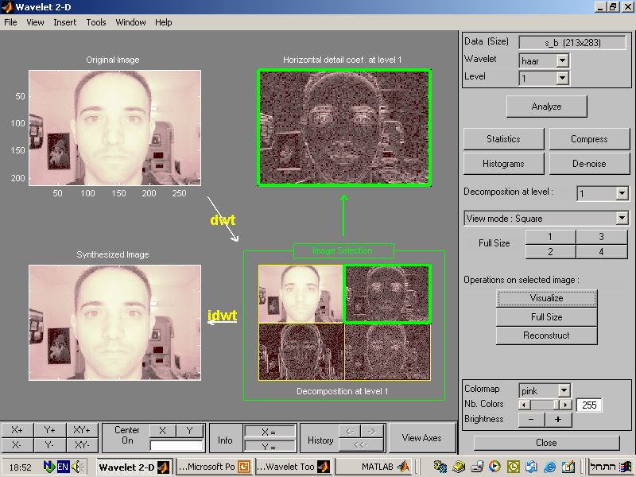

Slide 25
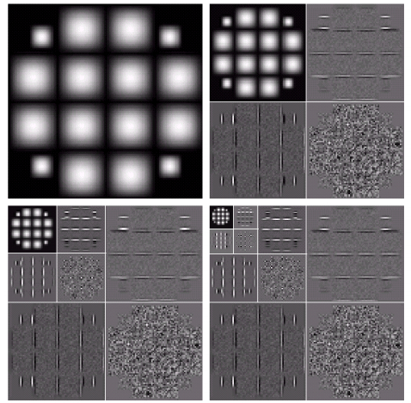
2 Wavelet Transform 2.1 The Discrete Wavelet Transform
Computing a 2-D three-scale FWT
a)The original image
b)a one-scale FWT
c)a two-scale FWT
d)a three-scale FWT
a
b
c
d

Slide 26
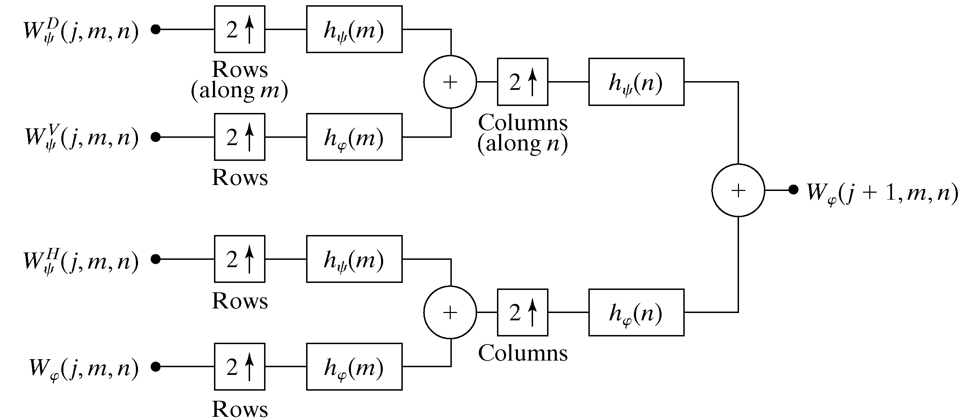
2 Wavelet Transform 2.1 The Discrete Wavelet Transform
two-level inverse DWT

Slide 27
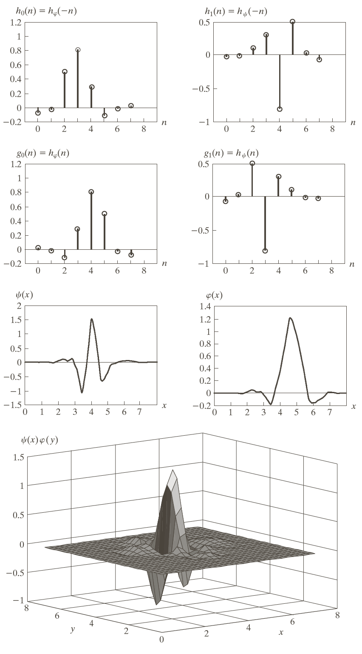
2 Wavelet Transform 2.1 The Discrete Wavelet Transform

Slide 28
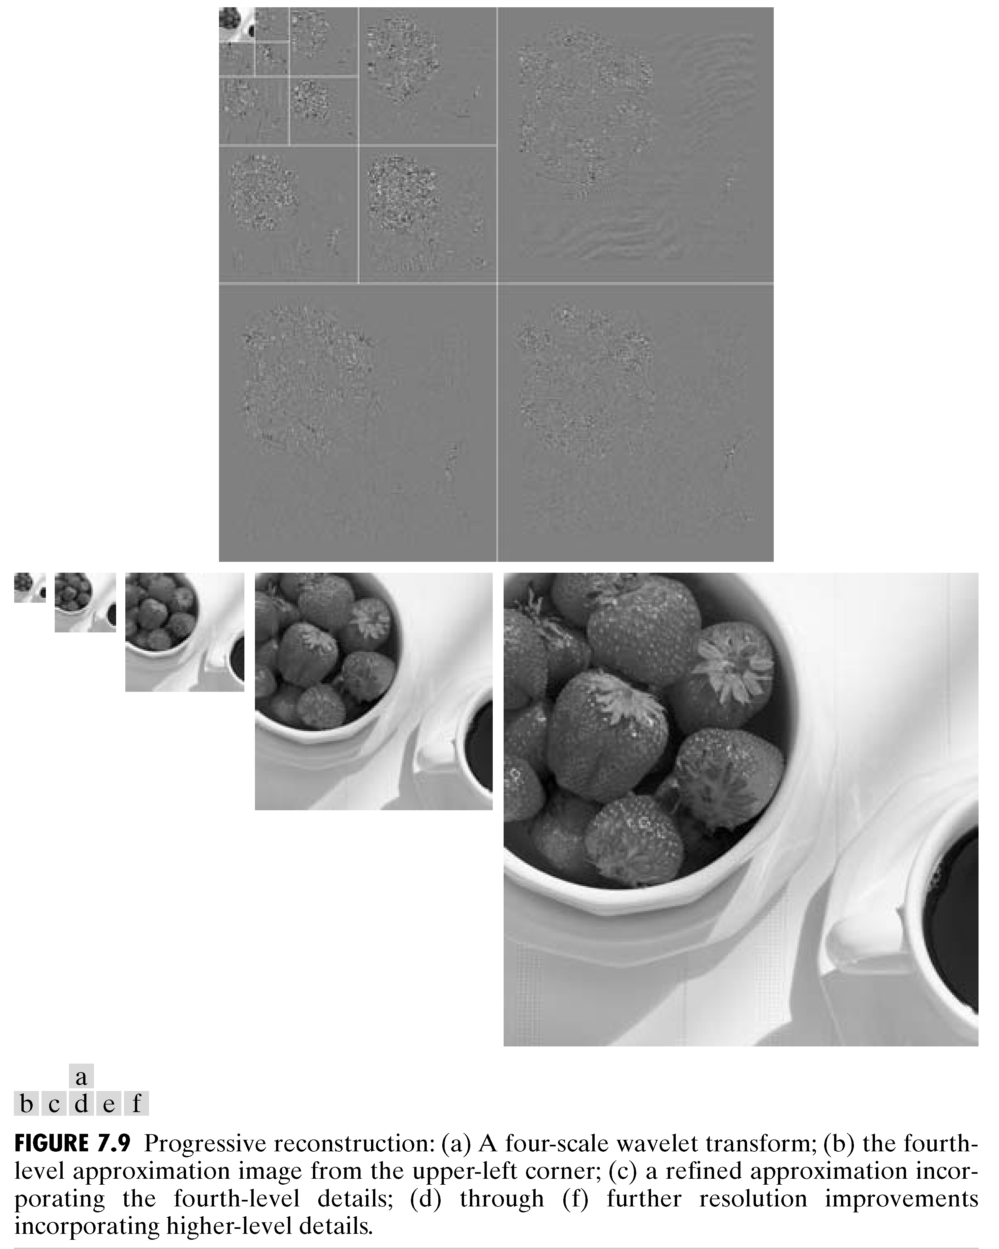
2 Wavelet Shrinkage Denoising 2.1 The Discrete Wavelet Transform

Slide 29
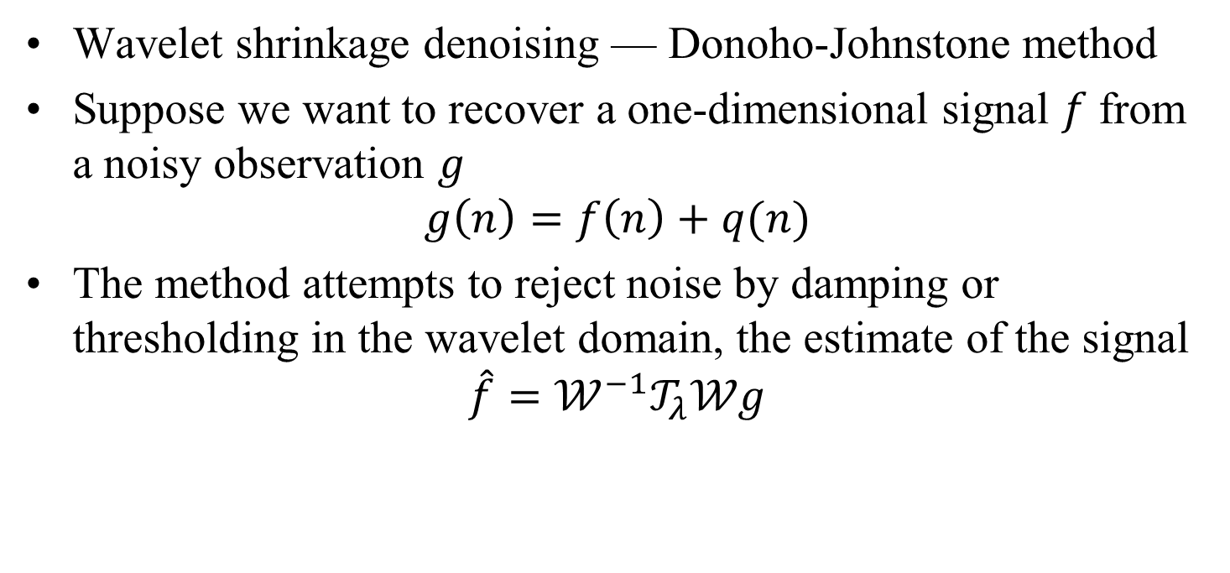
3 Wavelet Shrinkage Denoising 3.1 The Donoho-Johnstone Method
Wavelet shrinkage denoising — Donoho-Johnstone method
Suppose we want to recover a one-dimensional signal $f$ from a noisy observation $g$
$$g\left(n\right)=f\left(n\right)+q(n)$$
The method attempts to reject noise by damping or thresholding in the wavelet domain, the estimate of the signal
$$\hat{f}=𝒲^{−1}𝒯_{λ}𝒲g$$

Slide 30
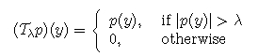
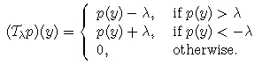
3 Wavelet Shrinkage Denoising 3.1 The Donoho-Johnstone Method
A thresholding operation attenuates noise energy by removing those small coefficients while maintaining signal energy by keeping these large coefficients unchanged
Hard thresholding
Soft thresholding

Slide 31
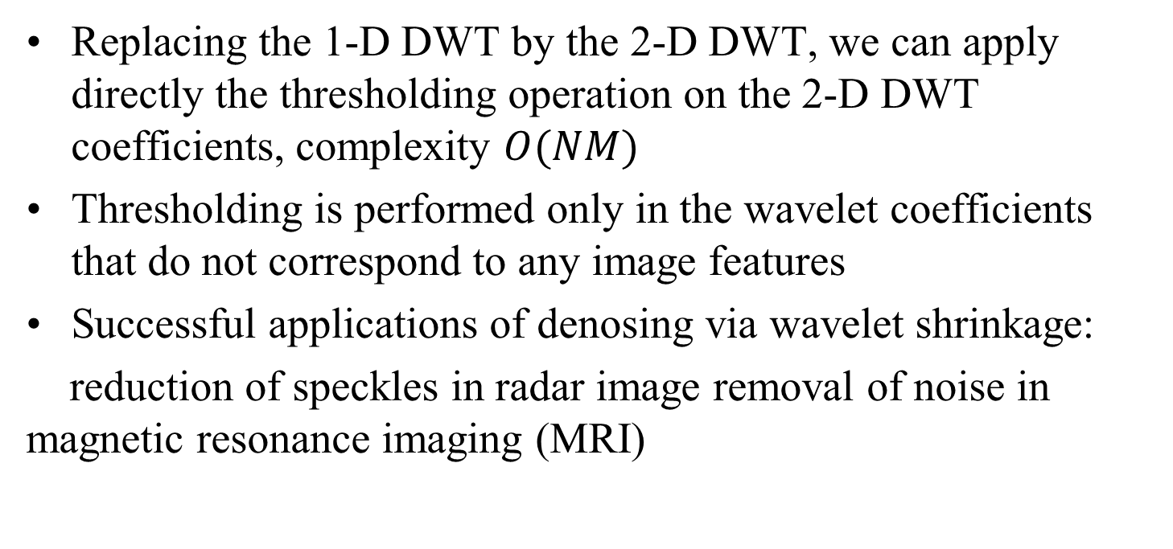
4 Image Enhancement via Wavelet Shrinkage 4.1 Suppression of Additive Noise
Replacing the 1-D DWT by the 2-D DWT, we can apply directly the thresholding operation on the 2-D DWT coefficients, complexity $O(NM)$
Thresholding is performed only in the wavelet coefficients that do not correspond to any image features
Successful applications of denosing via wavelet shrinkage:
reduction of speckles in radar image removal of noise in magnetic resonance imaging (MRI)

Slide 32
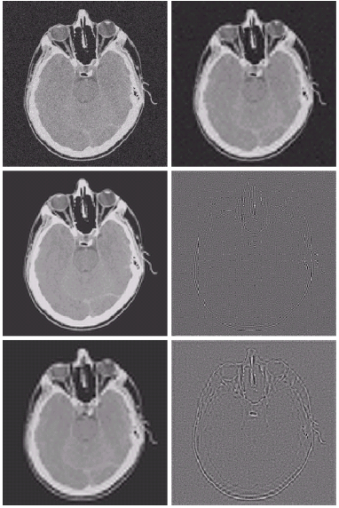
4 Image Enhancement via Wavelet Shrinkage
Modifying a DWT for noise removal:
(a) a noisy CT of a human head
(b)(c)(e) various reconstructions after thresholding the detail coefficients
(d)(f) the information removed during the reconstruction
(a)(b)
(c)(d)
(e)(f)

Slide 33
4 Image Enhancement via Wavelet Shrinkage

Slide 34
4 Image Enhancement via Wavelet Shrinkage 4.2 Removal of Blocking Artifacts in DCT-Coded Images
Lossy image coding is essential in many visual communication applications
the distortion caused by compression usually manifests itself as various perceptually annoying artifacts

Slide 35
Wavelet Image Compression
1 What Are Wavelets: why Are They Good for Image Coding?
2 The Compression Problem
3 The Transform Coding Paradigm

Slide 36
Wavelet Image Compression Why compression ?
Uncompressed images take too much space, require larger bandwidth for transmission and longer time to transmit
Examples:
512x512 grayscale image: 262KB
512x512 color image: 786KB
The common principle beyond compression is to reduce redundancy: spatial and spectral redundancy

Slide 37


Wavelet Image Compression Why Wavelets ?
Original JPEG:
Transform each 8x8 block using DCT
Since adjacent pixels are highly correlated, most of the coefficients are concentrated at lower frequencies.
Quantize the DCT coefficients (uniform quantization) and then entropy encode for further compression

Slide 38
Wavelet Image Compression Why Wavelets ?
Disadvantage of DCT:
DCT based JPEG uses blocks of image, there is still correlation across blocks.
Block boundaries are noticeable in some cases
Blocking artifacts at low bit rates
Can overlap the blocks→ Computationally expensive

Slide 39
Wavelet Image Compression Why Wavelets ?
No need to block the image
More robust under transmission errors
Facilitates progressive transmission of the image (Scalability)
Notes:
无需遮挡图像
在传输错误下更强大
促进图像的渐进传输（可伸缩性）

Slide 40
Wavelet Image Compression Compression problem
Lossless compression can reconstruct the original image, the compression ratios are of the order 2:1, or at most 3:1
Lossy compression discards redundant information, achieves higher compression ratios.
Lossy compression, rate-distortion(R-D) theory by Shannon, fundamental compression performance bounds are called the theoretical R-D bounds for the source: the minimum rate R needed to compress the source if the tolerable distortion level is D
Notes:
无损压缩可以重建原始图像，压缩比约为2：1，或者最高为3：1
有损压缩会丢弃冗余信息，从而实现更高的压缩率。
香农的有损压缩，率失真（R-D）理论，基本压缩性能范围称为源的理论R-D范围：如果可容忍的失真级别为D，则压缩源所需的最小速率R

Slide 41
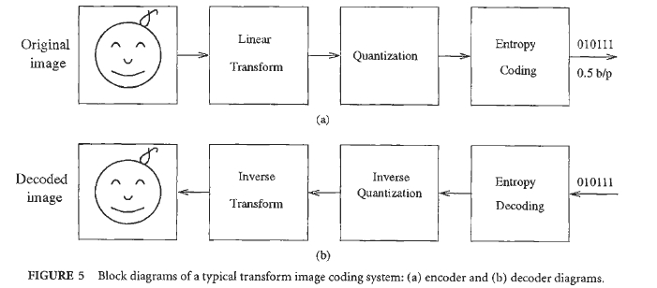
Wavelet Image Compression The Transform Coding Paradigm

Slide 42
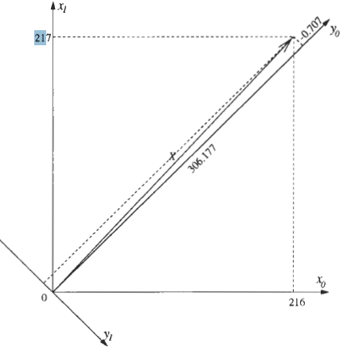
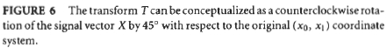
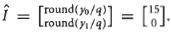
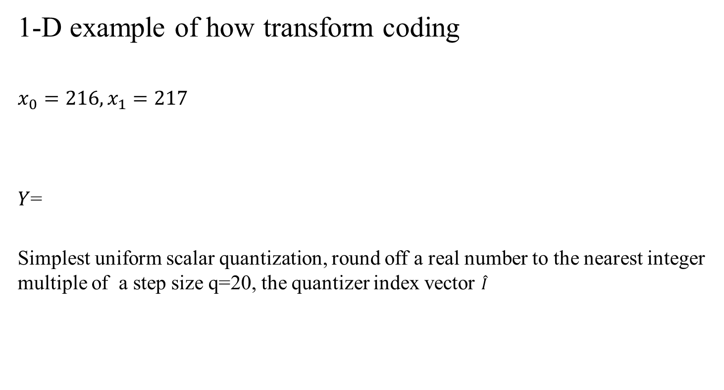
Wavelet Image Compression The Transform Coding Paradigm
1-D example of how transform coding
$$x_{0}=216, x_{1}=217$$
$Y$=
Simplest uniform scalar quantization, round off a real number to the nearest integer multiple of a step size q=20, the quantizer index vector $\hat{I}$

Slide 43
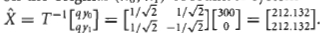
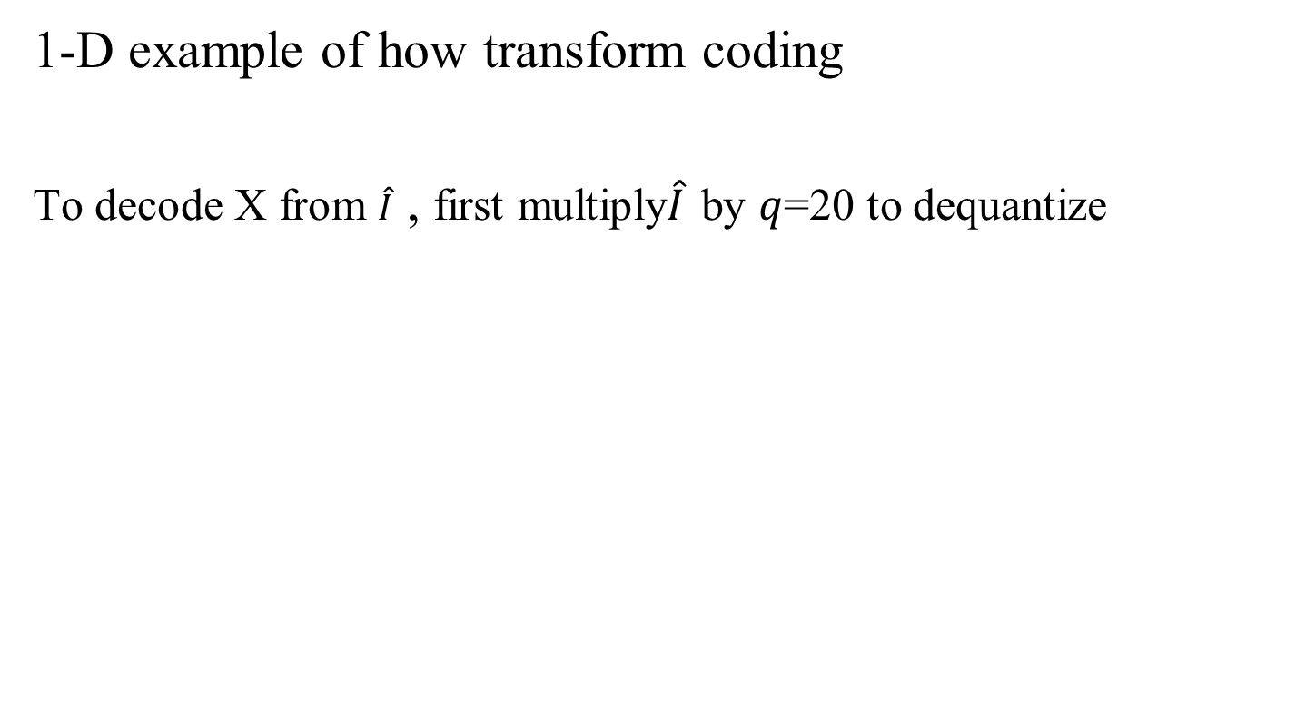
Wavelet Image Compression The Transform Coding Paradigm
1-D example of how transform coding
To decode X from $\hat{I}$ , first multiply$\hat{I}$ by $q$=20 to dequantize

Slide 44
Wavelet Image Compression The Transform Coding Paradigm
Transform structure
Quantization
fixed length uniform scalar quantizers, all quantization levels are assigned the same number of bits
fixed length non-uniform scalar quantizers, in which the quantizer step sizes are not all the same
Notes:
固定长度的统一标量量化器，所有量化级别均分配有相同的位数
固定长度的非均匀标量量化器，其中量化器步长不完全相同

Slide 45
Wavelet Image Compression The Transform Coding Paradigm
Entropy Coding
Like the Morse code: the frequently occurring symbols are represented by short codewords, whereas symbols occurring less frequently are represented by longer codewords

Slide 46
Wavelet Image Compression The Transform Coding Paradigm
Wavelet coding
image
Quantization
Entropy coding
bitstream
Quantization
uniform scalar quantization
separate quantization step-sizes for each subband
Entropy coding

Slide 47
Wavelet Image Compression Simulation Result
I₁
encoder
C
decoder
I₂
I₁: Original image with width W and height H
C: Encoded jpeg stream from I₁
I₂: Decoded image from C
CR (Compression Ratio) = sizeof(I₁) / sizeof(C)
RMS (Root mean square error) =

Slide 48



DCT-based image compression
Wavelet-based image compression
Original image
CR = 11.2460
RMS = 4.1316
CR = 10.3565
RMS = 4.0104

Slide 49


DCT-based image compression
Wavelet-based image compression
Original image
CR = 53.4333
RMS = 10.9662
CR = 51.3806
RMS = 9.6947

Slide 50
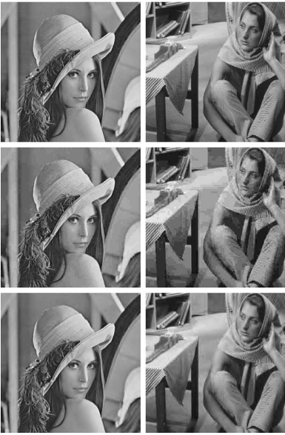
Wavelet Image Compression Class of Wavelet Coders
Subband coding: the early days

